Slide 1
Data Structures
Time Complexity – Introduction

Slide 2
Complexity – Introduction

Slide 3

Data Structure –Complexity
Introduction
Solution 1
Solution 5
Solution 2
Solution 4
Solution 3

Slide 4

Data Structure –Complexity
Introduction
Solution 1
Solution 5
Solution 2
Solution 4
Solution 3

Slide 5
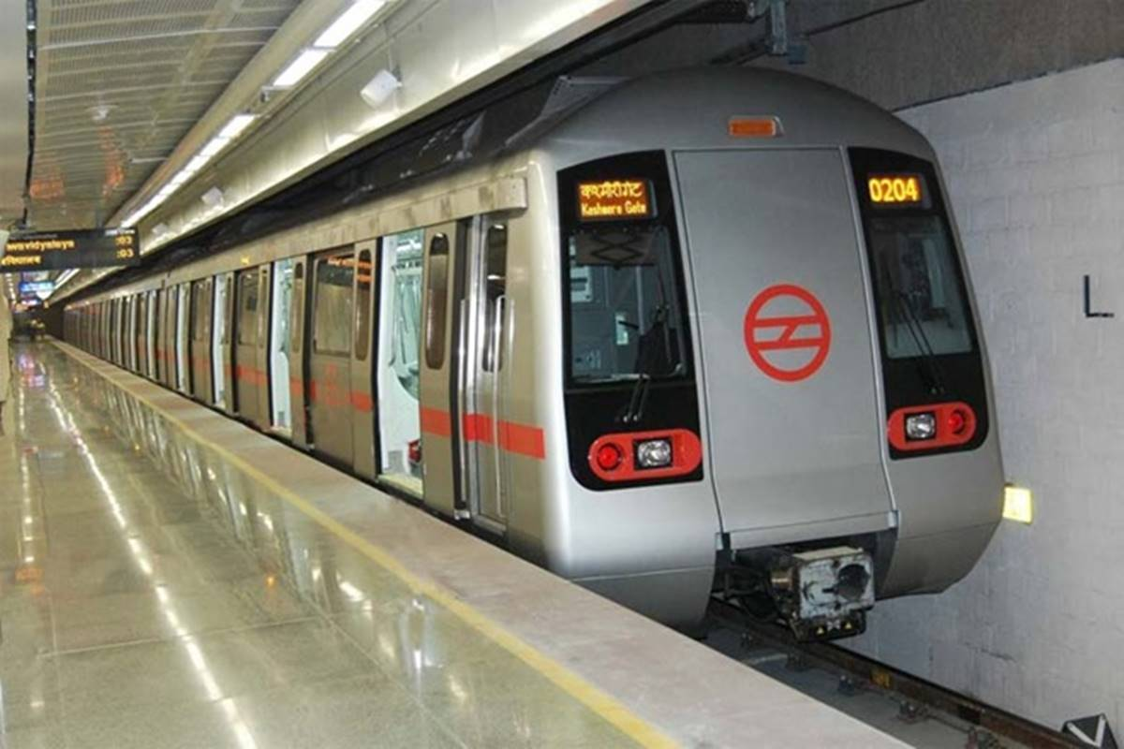
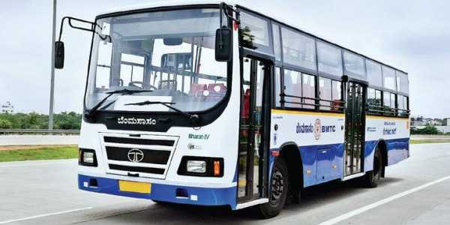
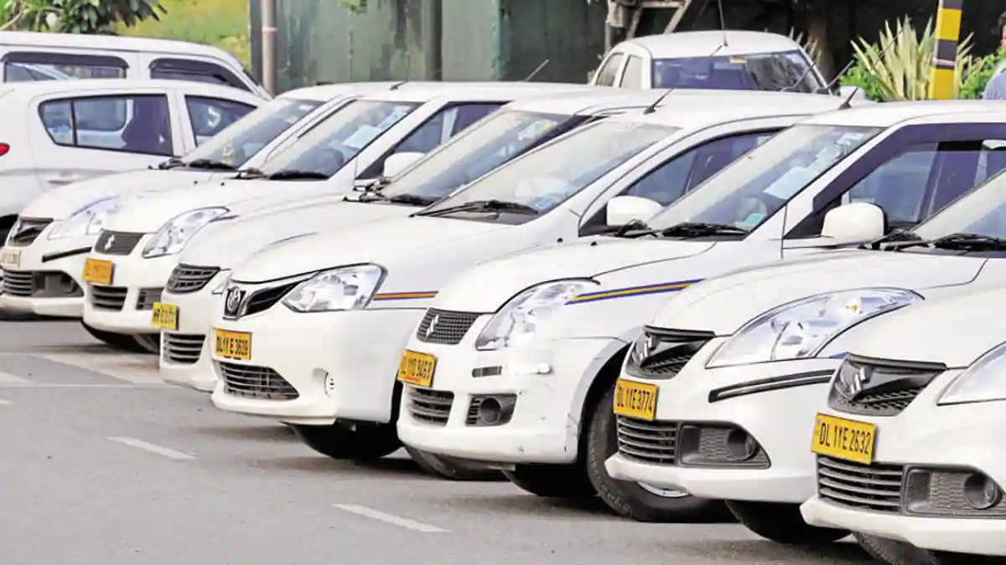
Data Structure –Complexity
Introduction

Slide 6
Data Structure –Complexity
Introduction
Program
Algorithm 1
Algorithm 2
Algorithm 3

Slide 7
Data Structure –Complexity
Introduction
Performance analysis
Space Complexity
Time Complexity

Slide 8
Data Structure –Complexity
Introduction
Space Complexity
Amount of memory it takes to run the program completely and efficiently
Time Complexity
Amount of time it takes to run the program completely and efficiently

Slide 9
Data Structure –Complexity
Introduction
Asymptotic notations
These are mathematical tools to represent time and space complexity of algorithm
Types
Big Ohmega
Big Theta
Big Oh

Slide 10
Data Structure –Complexity
Introduction
Code
Mathematical Equation
Experiment
Non Experiment
Time consuming
Input size

Slide 11
Data Structure –Complexity
Introduction
Code
for ( i = 1; i<= n ; i++ )
{
    count++;
}

Slide 12
Data Structure –Complexity
Introduction
Primitive Operation
Code
1
for ( i = 1; i<= n ; i++ )
{
    count++;
}

Slide 13
Data Structure –Complexity
Introduction
Code
n = 3
1
n+1
for ( i = 1; i<= n ; i++ )
{
    count++;
}

Slide 14
Data Structure –Complexity
Introduction
Code
n = 3
1
n+1
for ( i = 1; i<= n ; i++ )
{
    count++;
}
n

Slide 15
Data Structure –Complexity
Introduction
Code
n = 3
1
n+1
n
for ( i = 1; i<= n ; i++ )
{
    count++;
}
n

Slide 16
Data Structure –Complexity
Introduction
Code
n = 3
1
n+1
n
for ( i = 1; i<= n ; i++ )
{
    count++;
}
n
= 1+n+1+n+n
= 3n + 2
= O( 3n + 2 )

Slide 17
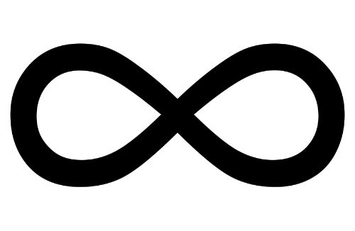
Data Structure –Complexity
Introduction
Code
n = 3
1
n+1
n
for ( i = 1; i<= n ; i++ )
{
    count++;
}
n
= 1+n+1+n+n
= 3n + 2
= O( 3n + 2 )
= O(3n) + O(2)
n
= O(3n)

Slide 18
Data Structure –Complexity
Introduction
Code
n = 3
1
n+1
n
for ( i = 1; i<= n ; i++ )
{
    count++;
}
n
= 1+n+1+n+n
= 3n + 2
= O( 3n + 2 )
= O(3n) + O(2)
n
= O(3n)
= 3 O(n)

Slide 19
Data Structure –Complexity
Introduction
Code
for ( i = 1; i<= n ; i++ )
{
    count++;
}
T(n) = O(n)

Slide 20
Time Complexity – Part 1

Slide 21
Data Structure –Time Complexity
Introduction
Time Complexity
Amount of time required to run the program completely and efficiently

Slide 22
Data Structure –Time Complexity
Introduction
Time Complexity
Amount of time required to run the program completely and efficiently
Time – Number of memory access
Number of comparision
Number of time some loop is executed

Slide 23
Data Structure –Time Complexity
Example
Linear
for ( i = 1; i<= n ; i++ )
{
    count++;
}
T(n) = O(n)

Slide 24
Data Structure –Time Complexity
Example
Linear
for ( i = n; i >= 1 ; i-- )
{
    count++;
}

Slide 25
Data Structure –Time Complexity
Example
Linear
n = 3
1
for ( i = n; i >= 1 ; i-- )
{
    count++;
}

Slide 26
Data Structure –Time Complexity
Example
Linear
n = 3
1
n+1
for ( i = n; i >= 1 ; i-- )
{
    count++;
}

Slide 27
Data Structure –Time Complexity
Example
Linear
n = 3
1
n+1
for ( i = n; i >= 1 ; i-- )
{
    count++;
}
n

Slide 28
Data Structure –Time Complexity
Example
Linear
n = 3
1
n+1
n
for ( i = n; i >= 1 ; i-- )
{
    count++;
}
n

Slide 29
Data Structure –Time Complexity
Example
Linear
n = 3
1
n+1
n
for ( i = n; i >= 1 ; i-- )
{
    count++;
}
n
= 1+n+1+n+n
= 3n + 2
= O( 3n + 2 )

Slide 30
Data Structure –Time Complexity
Example
Linear
n = 3
1
n+1
n
for ( i = n; i >= 1 ; i-- )
{
    count++;
}
n
= 1+n+1+n+n
= 3n + 2
= O( 3n + 2 )
= O(3n) + O(2)
n
= O(3n)

Slide 31
Data Structure –Time Complexity
Example
Linear
n = 3
1
n+1
n
for ( i = n; i >= 1 ; i-- )
{
    count++;
}
n
= 1+n+1+n+n
= 3n + 2
= O( 3n + 2 )
= O(3n) + O(2)
n
= O(3n)
= 3 O(n)

Slide 32
Data Structure –Time Complexity
Example
Linear
for ( i = n; i >= 1 ; i-- )
{
    count++;
}
T(n) = O(n)

Slide 33
Data Structure –Time Complexity
Example
Sequential for Loop
for ( i = 1; i <= n ; i++ )
{
    count++;
}
T(n) = O(n)
for ( i = 1; i <= n ; i++ )
{
    k++;
}

Slide 34
Data Structure –Time Complexity
Example
Sequential for Loop
T(C) = O(n) + O(n)
for ( i = 1; i <= n ; i++ )
{
    count++;
}
T(n) = O(n)
T(n) = 2O(n)
for ( i = 1; i <= n ; i++ )
{
    k++;
}
T(n) = O(n)

Slide 35
Data Structure –Time Complexity
Example
Nested for Loop
for ( i = 1; i <= n ; i++ )
{
T(n) = O(n)
for ( j = 1; j <= n ; j++ )
{
    k++;
}
}

Slide 36
Data Structure –Time Complexity
Example
Nested for Loop
T(C) = O(n) * O(n)
for ( i = 1; i <= n ; i++ )
{
T(n) = O(n)
for ( j = 1; j <= n ; j++ )
{
    k++;
}
T(n) = O(n^2)
}

Slide 37
Data Structure –Time Complexity
Example
Simple Statement

Slide 38
Data Structure –Time Complexity
Example
Simple Statement
k++;
T(n) = O(1)

Slide 39
Data Structure –Time Complexity
Example
Non Linear for Loop
for ( i = 1; i < n ; i = i * 2 )
{
    c++;
}

Slide 40
Data Structure –Time Complexity
Example
Non Linear for Loop
for ( i = 1; i < n ; i = i * 2 )
{
    c++;
}
n = 16
i < n
2 ^ 0
1 < 16
2 ^ 1
2 < 16
4 < 16
2 ^ 2
2 ^ 3
8 < 16
2 ^ 4
16 < 16

Slide 41
Data Structure –Time Complexity
Example
Non Linear for Loop
for ( i = 1; i < n ; i = i * 2 )
{
    c++;
}
n = 16
i < n
2 ^ 0
1 < 16
i = n
2 ^ 1
2 < 16
4 < 16
2 ^ 2
2^k = n
2 ^ 3
8 < 16
2 ^ 4
k= log₂n
16 < 16
T(n)=O(log₂n)

Slide 42
Data Structure –Time Complexity
Example
Non Linear for Loop
for ( i = n; i >= 1 ; i = i / 2 )
{
    c++;
}

Slide 43
Data Structure –Time Complexity
Example
Non Linear for Loop
for ( i = n; i >= 1 ; i = i / 2 )
{
    c++;
}
n = 16
i >= 1
2 ^ 4
16 > 1
2 ^ 3
8 > 1
4 > 1
2 ^ 2
2 ^ 1
2 > 1
2 ^ 0
1 = 1

Slide 44
Data Structure –Time Complexity
Example
Non Linear for Loop
for ( i = n; i >= 1 ; i = i / 2 )
{
    c++;
}
n = 16
i >= 1
2 ^ 4
16 > 1
2 ^ 3
8 > 1
2^k = n
4 > 1
2 ^ 2
2 ^ 1
2 > 1
k= log₂n
2 ^ 0
1 = 1
T(n)= O(log₂n)

Slide 45
Data Structure –Time Complexity
Example
Non Linear for Loop
for ( i = 1; i * i <= n ; i++ )
{
    k++;
}

Slide 46
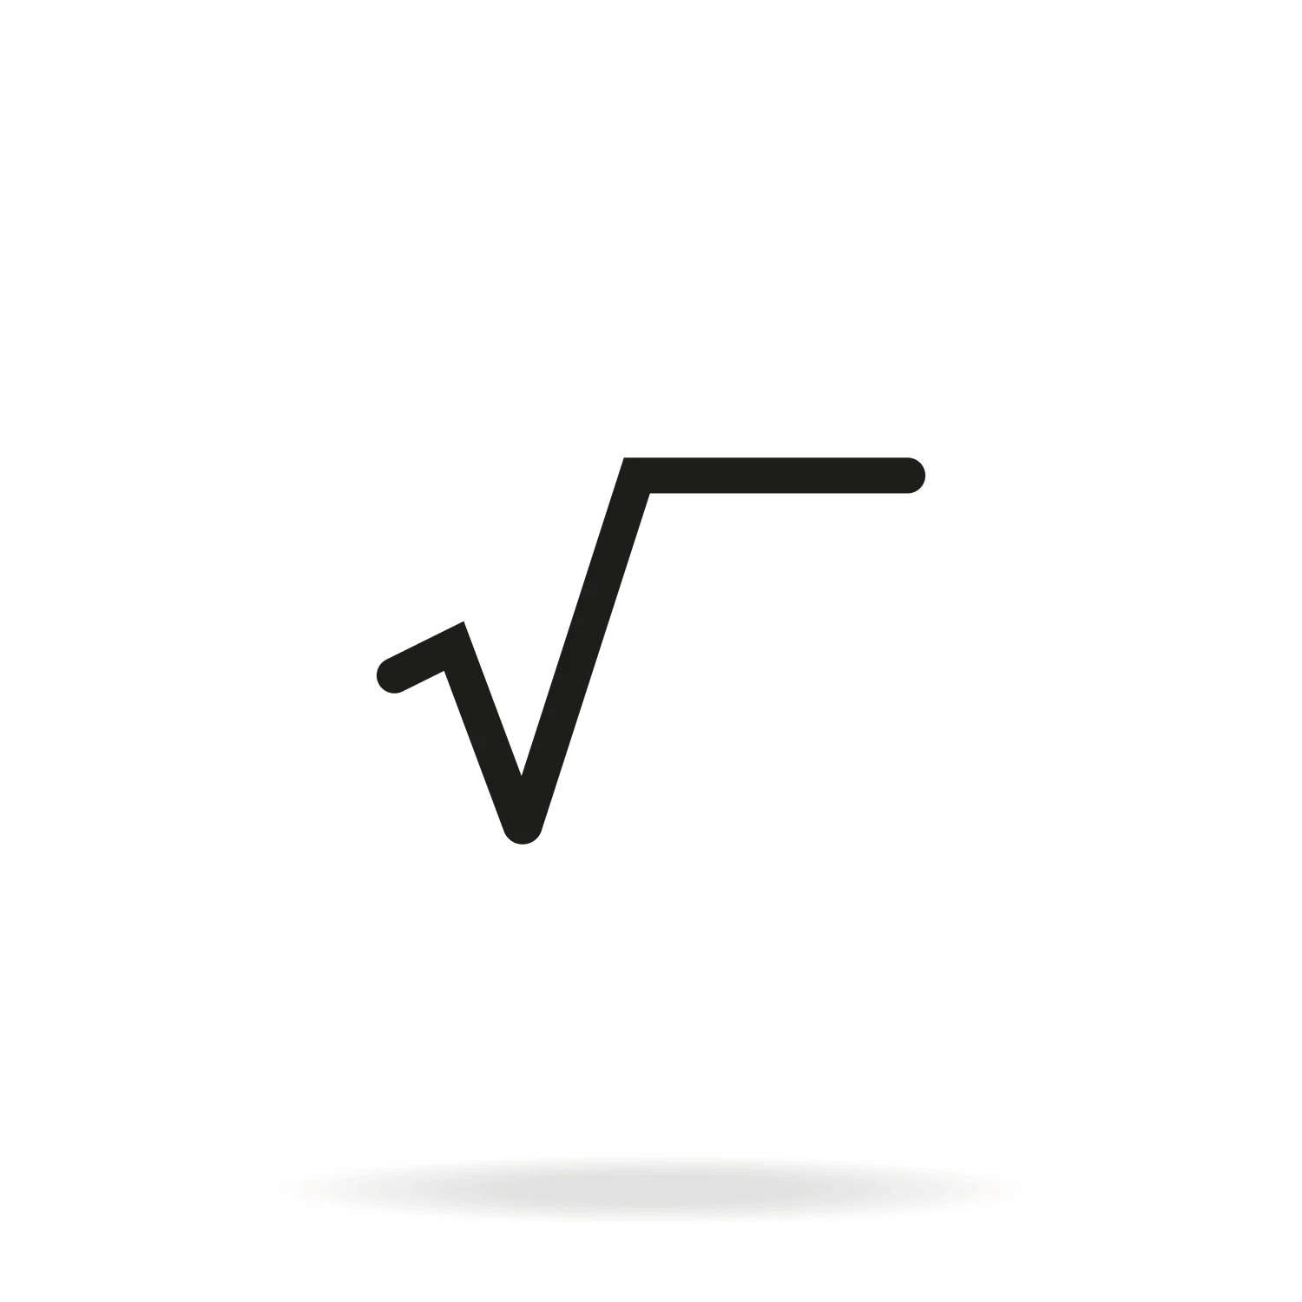
Data Structure –Time Complexity
Example
Non Linear for Loop
for ( i = 1; i * i <= n ; i++ )
{
    k++;
}
n = 16
i * i <= n
1 * 1 <= 16
2 * 2 <= 16
3 * 3 <= 16
4 * 4 = 16
O ( n )
T(n) =
25 <= 16

Slide 47
Data Structure –Time Complexity
Example
n = 100
for ( i = n / 2; i <= n ; i++ )
{
1
100
50
for ( j = 1; j + n/2 <= n ; j++ )
{
for ( k = 1; k <= n ; k = k * 2 )
{
    k++;
}

Slide 48
Data Structure –Time Complexity
Example
n = 100
{
for ( i = n / 2; i <= n ; i++ )
{
1
100
50
for ( j = 1; j + n/2 <= n ; j++ )
{
for ( k = 1; k <= n ; k = k * 2 )
{
    k++;
}

Slide 49
Data Structure –Time Complexity
Example
n = 100
{
for ( i = n / 2; i <= n ; i++ )
{
1
100
50
for ( j = 1; j + n/2 <= n ; j++ )
{
for ( k = 1; k <= n ; k = k * 2 )
{
    k++;
}
T(C) = O( n / 2)

Slide 50
Data Structure –Time Complexity
Example
n = 100
{
for ( i = n / 2; i <= n ; i++ )
{
1
100
50
for ( j = 1; j + n/2 <= n ; j++ )
{
T(C) = O( n / 2)
for ( k = 1; k <= n ; k = k * 2 )
{
    count++;
}
T(C) = O( (n / 2 ) * (n / 2)
T(C) = O(n ^2 / 4 )

Slide 51
Data Structure –Time Complexity
Example
n = 100
for ( i = n / 2; i <= n ; i++ )
{
1
100
50
for ( j = 1; j + n/2 <= n ; j++ )
{
for ( k = 1; k <= n ; k = k * 2 )
{
    count++;
}
T(C) = O( (n / 2 ) * (n / 2)
T(C) = O(n ^2 / 4 )
T(C) = O((n ^2 / 4) * logn )

Slide 52
Data Structure –Time Complexity
Example
n = 100
for ( i = n / 2; i <= n ; i++ )
{
1
100
50
for ( j = 1; j + n/2 <= n ; j++ )
{
for ( k = 1; k <= n ; k = k * 2 )
{
    count++;
}
T(n) = O( (n / 2 ) * (n / 2)
T(n) = O(n ^2 / 4 )
T(n) = O((n ^2 ) * logn )

Slide 53
Time Complexity -Recursion

Slide 54
Data Structure –Time Complexity
Recursive Tree
void foo(int n)
{
    if( n > 0)
    {
        printf(“%d”,n);
        foo(n-1);
}
}
foo(3)

Slide 55
Data Structure –Time Complexity
Recursive Tree
foo(3)
void foo(int n)
{
    if( n > 0)
    {
        printf(“%d”,n);
        foo(n-1);
}
}
3
foo(2)
foo(3)

Slide 56
Data Structure –Time Complexity
Recursive Tree
foo(3)
void foo(int n)
{
    if( n > 0)
    {
        printf(“%d”,n);
        foo(n-1);
}
}
3
foo(2)
2
foo(1)
foo(3)

Slide 57
Data Structure –Time Complexity
Recursive Tree
foo(3)
void foo(int n)
{
    if( n > 0)
    {
        printf(“%d”,n);
        foo(n-1);
}
}
3
foo(2)
2
foo(1)
1
foo(0)
foo(3)

Slide 58
Data Structure –Time Complexity
Recursive Tree
foo(3)
void foo(int n)
{
    if( n > 0)
    {
        printf(“%d”,n);
        foo(n-1);
}
}
3
foo(2)
2
foo(1)
1
foo(0)
foo(3)

Slide 59
Data Structure –Time Complexity
Recursive Tree
foo(3)
void foo(int n)
{
    if( n > 0)
    {
        printf(“%d”,n);
        foo(n-1);
}
}
3
foo(2)
2
foo(1)
1
foo(0)
foo(3)
TC = O(n+1)

Slide 60
Data Structure –Time Complexity
Recursive Tree
foo(3)
void foo(int n)
{
    if( n > 0)
    {
        printf(“%d”,n);
        foo(n-1);
}
}
3
foo(2)
2
foo(1)
1
foo(0)
TC = O(n)

Slide 61
Data Structure –Time Complexity
Example
Range
1 < logn < root(n) < n < nlogn < n² < n³ < ..................< n^{n}

